Slide 1

Chapter Three:
The Use of Theory

Slide 2

Chapter Outline
The Use of Theory
Quantitative Theory Use
Variables in Quantitative Research
Definition of a Theory in Quantitative Research
Forms of Theories in Quantitative Research
Placement of Quantitative Theories
Writing a Quantitative Theoretical Perspective
   Example 3.1. A Quantitative Theory Section
Qualitative Theory Use
Variation in Theory Use in Qualitative Research
Locating the Theory in Qualitative Research
Example 3.2. A Theory Early in a Qualitative Study
Example 3.3. A Theory at the End of a Qualitative Study
Mixed Methods Theory Use
Social Science Theory Use
Transformative Paradigm Theory Use
Example 3.4. Theory in a Transformative Mixed
Methods Study
Summary
Writing Exercises
Additional Readings

Slide 3
The Use of Theory
The literature determines what theories may be used to examine the research questions
Quantitative tests theories as explanations
Qualitative studies may generate the theory
Mixed methods studies may have no theories at all or a theoretical framework in which both quantitative and qualitative data are collected

Slide 4
Variables in Quantitative Research
A variable is a characteristic of an individual or group that is measurable.
Examples of variables in a study may include age, gender and socioeconomic status.
Variables may have temporal order, or be measurable or observable.
Another term for a variable is a construct.

Slide 5
Variables in Quantitative Research Cont.
Independent
  Variables that probably cause outcomes
Dependent
  The outcomes that depend on the independent variables
Intervening or mediating
  Variables that stand between the independent and dependent variables
Moderating
  New variables that measure the joint impact of two variables
Control
  Independent variables that are measured and statistically "controlled"
Confounding
  Variables that could also affect the dependent variables, but cannot or will not be measured

Slide 6
Theories in Quantitative Research
Here a theory is a scientific predication or explanation of what the Researcher expects to find out about a set of interrelated variables.
When a Researcher uses a theory to predict the anticipated outcome of a study he/she has created the hypothesis.
As the Researcher conducts the study and puts forward an explanation for his/her predictions and study findings, he/she is presenting his/her theory.

Slide 7
Theories in Quantitative Research
Micro-level theories: limited to a small segment of time, place or number of people
Meso-level theories: link micro-level and macro-level theories
Macro-level theories: explain larger scales, for example the entire society

Slide 8
Forms of Theories in Quantitative Research
Theory
  Interrelated set of constructs formed into propositions that specify the relationships among variables
  Describes how and why variables are related
Forms include
  Set of hypotheses: These are interconnected and demonstrate a process
  Series of if-then statements: These explain why one would expect an independent variable to influence or cause a dependent variable
  Visual model: These allow the reader to visualize the interconnections between the variables

Slide 9
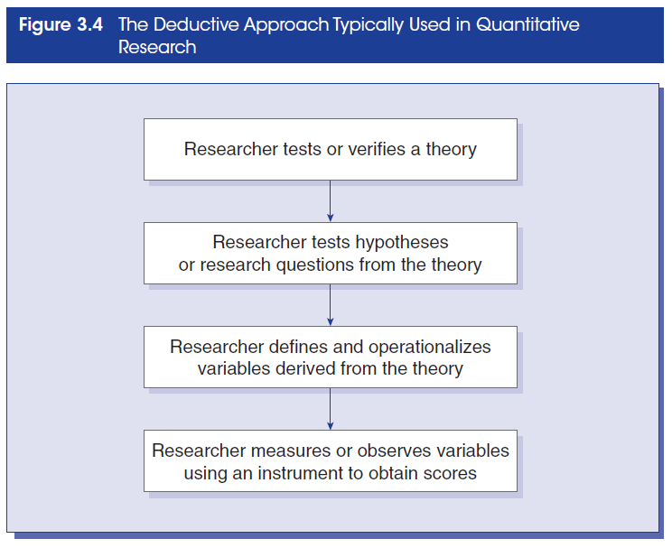
The Deductive Approach Used in Quantitative Research

Slide 10
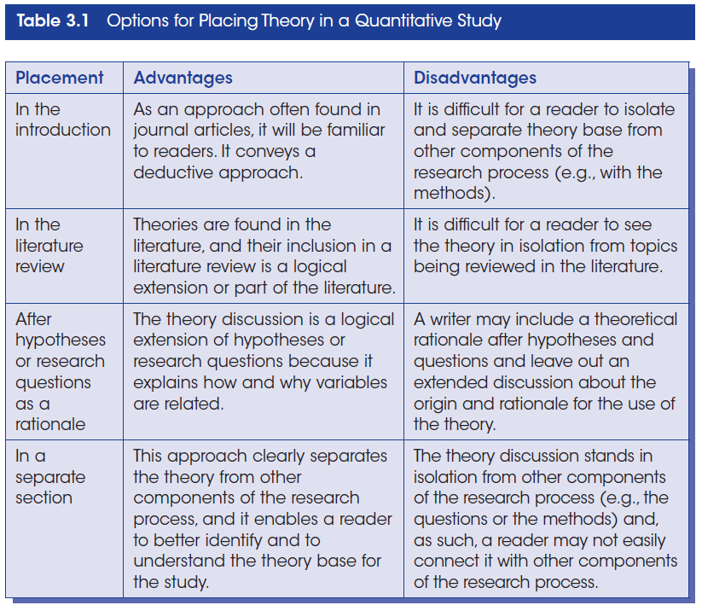
Placing Theory in a Quantitative Study

Slide 11
Quantitative Theoretical Perspective
Examine discipline specific literature (psychological, sociological or a combination of both).
Examine the existing body of knowledge on the topic and related topics.
Look for connections between the independent and the dependent variables.
Script out the theory section. (See Example 3.1)
  Name the theory you plan to use
  State the central hypothesis of the theory
  Present information about who has used the theory and its applicability
  Present an adoption of the theory to the variables of your study using if-then logic

Slide 12
Qualitative Theory Use
Provides broad explanations: Themes provide the context for hypothesis to be tested from the literature.
Provides theoretical lens for the examination of issues of marginalized groups: This allows for a transformative perspective as it influences the questions asked, the data collected and analyzed and the research outcomes.
The theory becomes the end point: Most qualitative research is an inductive process building from the data to the broad themes to a generalized model or theory (See Figure 3.5).
No explicit theory: Some qualitative studies build from detailed descriptions of phenomenon.

Slide 13
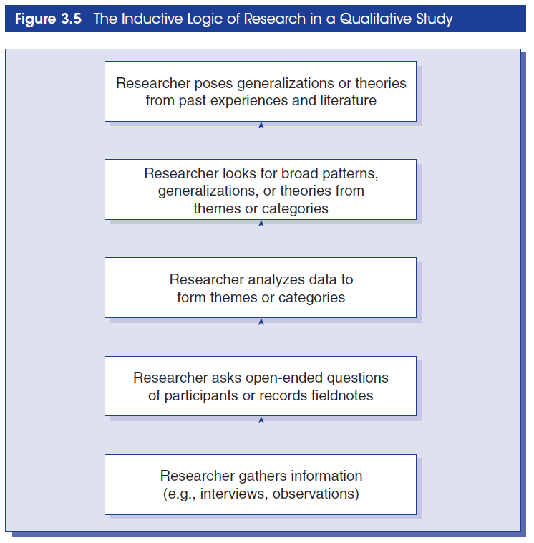
The Inductive Logic of Research in a Qualitative Study

Slide 14
Qualitative Theoretical Perspectives
Feminist perspective
Racialized discourse
Critical theory
Queer theory
Disability inquiry
  An endpoint, a theory that is generated
Researcher may also choose not to employ theory in a qualitative study

Slide 15
Tips for Using Theory in Qualitative Study
First decide if you will use a theory in your study.
If you decide to use a theory, identify the theory that will be used using the transformative or advocacy lens.
Place the narratives about the theory early in the research proposal or at the end of the proposal.

Slide 16
Locating Theory in a Qualitative Study
Studies based on cultural themes or theoretical lens: The theory is placed in the opening passages.
Studies based on emerging design or qualitative inquiry: The theory appears in the beginning and is modified as the study progresses.
Studies based on grounded theory or reciprocal relationships: The data determines the theory that is used.
See Examples 3.2 and 3.3

Slide 17
Use of Theory in Mixed Methods
Mixed methods studies may:
  Include theory deductively (theory testing and validity)
  Include theory inductively (an emerging theory or pattern)
  Use a theoretical lens or perspective to guide the study

Slide 18
Social Science Theory Use
In Social Science research the theory is the overarching framework:
The theory is placed at the beginning of the study and guides the questions/hypothesis.
The theory is named and described and it informs the explanation of the major variables in the study.
The theory may be diagrammed that indicate the causal links between the primary variables or concepts.
The theory guides the data collection process.
The theory informs the findings of the study and provides a basis for comparison with other studies.

Slide 19
Transformative Paradigm Theory Use
There is growing use of Transformative Theory use in mixed methods studies.
This approach is still evolving and is primarily applied to discriminated and oppressed groups, while it recognizes diversity among study participants.
Assumptions based on inclusion and challenging oppression.
Designed to build trust.
Use of results to enhance social justice.
See Box 3.1

Slide 20
Using Transformative Theory
Indicate at the beginning that transformative theory is in use.
Early in the study, outline the framework.
Connect the theory with the existing body of knowledge on the topic.
Involve the community of interest in the process of the research.
Take a stance with the research question.
Talk about your experience as a researcher.
End the study: Advocate for change.
See Example 3.4

